Slide 1
Checkers Application 1.0
John O’Halloran and Myo Thet Tun

Slide 2
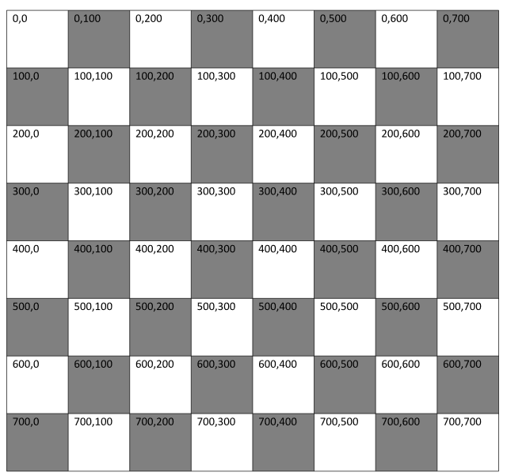
Planning
First version of the board
Used a simple conceptual model initially
Converted this to a 8x8 matrix later on

Slide 3
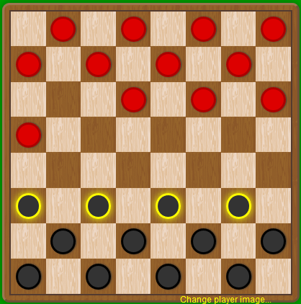
Planning - Logic
Implement the board
Place checkers on the board
Do simple movements (moving to empty tiles)
Capturing enemy pieces
Piece promotion and associated movement/capture logic
Highlighting
https://cardgames.io/checkers/

Slide 4
PlanninG the User Interface
Create the game panel and an empty game board
Implement panel functionality according to the requirements
Create a menu to enable users to start new game, change settings, and access help dialogues

Slide 5
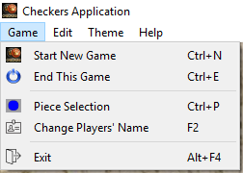
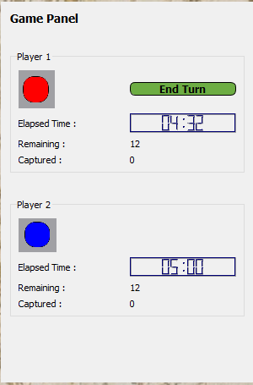
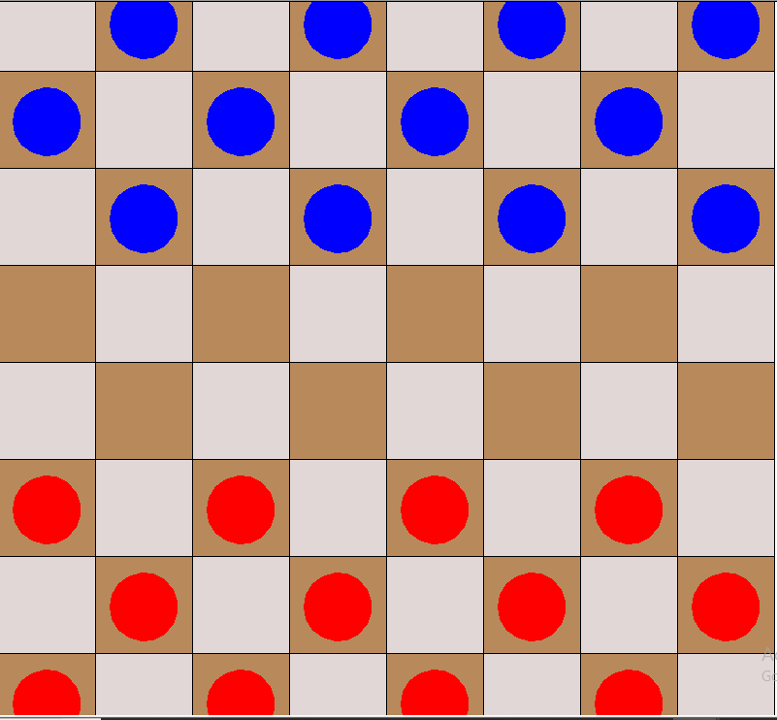
Putting it together
Modify our codebases to work together
Call the checkers game from within the UI
Bug fixing!
Next version?

Slide 6
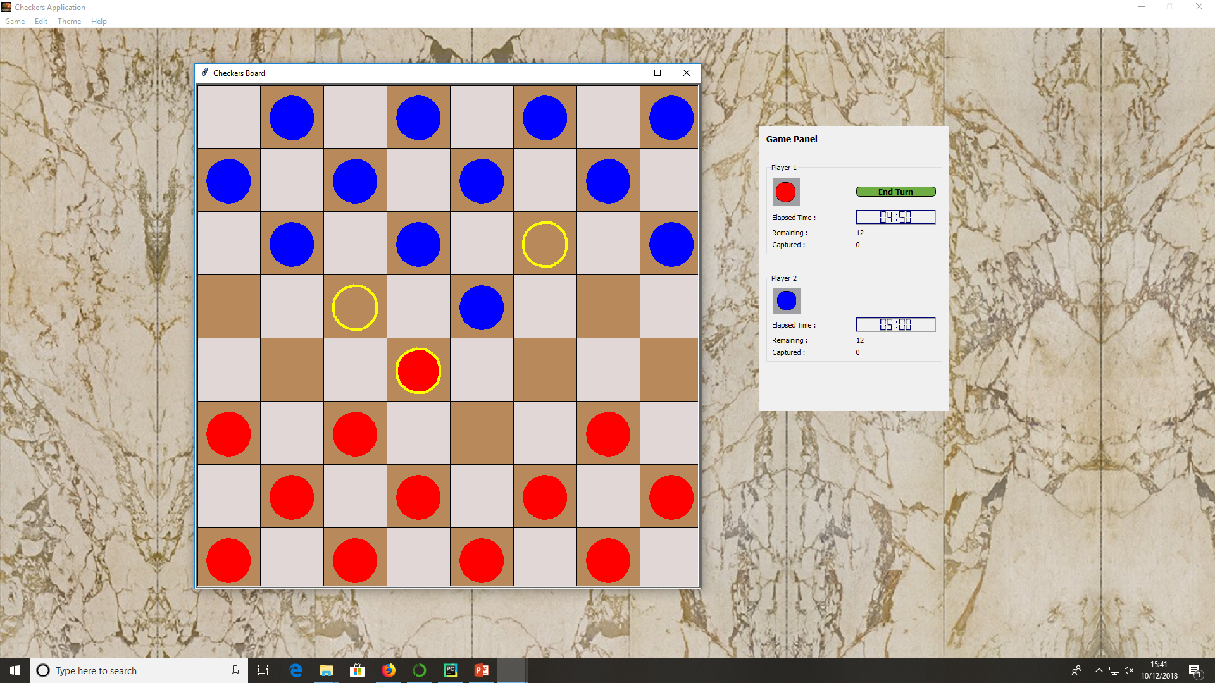

Slide 7
Some of Hci & GUI concepts used
Clear backgrounds and readable fonts (help users easy to read)
Highlights on pieces and movements and game panel (give information to users)
Simple and easy to use, undo and redo, confirm message boxes (help recover back)
Windows standard controls and shortcuts only (easy to get familiar in no time)

Slide 8
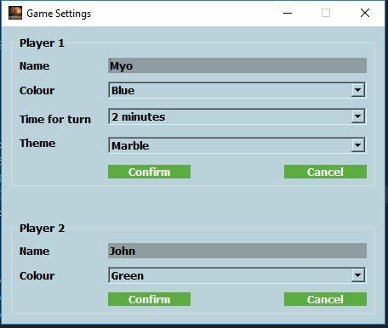
Future improvements
Checkers Application 2.0
Undo and redo movements
Game settings dialog box before starting the game
‘’End this game” and “Restart new game” functions
Simplify the movement logic
Update the board and checkers with proper icons to get actual appearance
More themes

Slide 9

if presentation.end == True:
print(“The End”)
print(“Thank you for listening”)
presentation.close()

